Slide 1


Digital Fingerprint Protection DLL Injector
Privacy protection
Machine learning
Prevents info. requests from sites
Protects user’s digital fingerprint
Protects user’s device
Uses ML algorithm
Adaptable for future fingerprinting techniques
User Digital Fingerprint
Protection Using Machine
Learning
By team Acedia:
Abdullah Adil AlSharji
Lead developer
Martin Hanna
Statistics and ML Model development
Nasser Mohammed AlKhaifi
Web-app developer

Slide 2
Digital Fingerprint Protection DLL Injector
User Digital Fingerprint
Protection Using Machine
Learning
Privacy protection
Machine learning
~265%
Growth in global revenue by 2032
Prevents info. requests from sites
Protects user’s digital fingerprint
Protects user’s device
Uses ML algorithm
Adaptable for future fingerprinting techniques
By team Acedia:
Abdullah Adil AlSharji
Lead developer
Martin Hanna
Statistics and ML Model development
Nasser Mohammed AlKhaifi
Web-app developer
Source: Fortune Business Insights; September 30, 2024

Slide 3
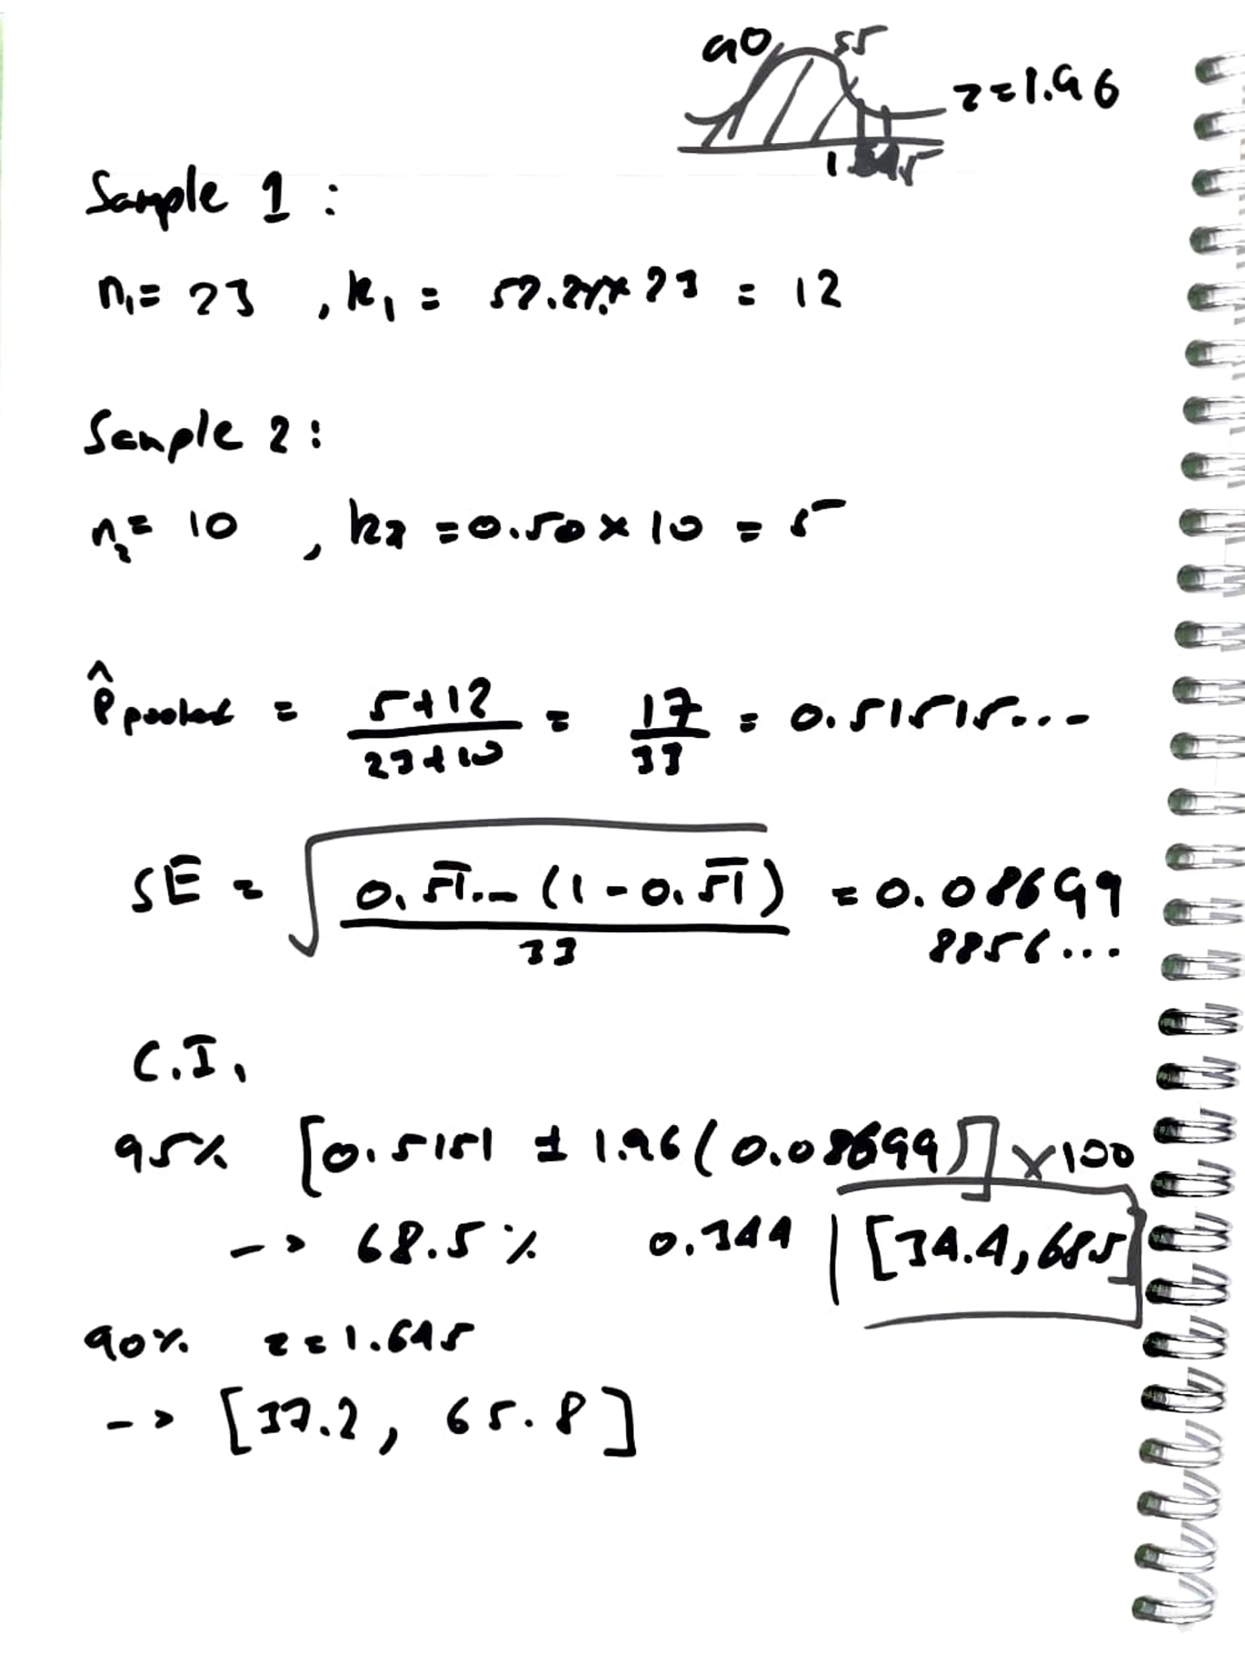
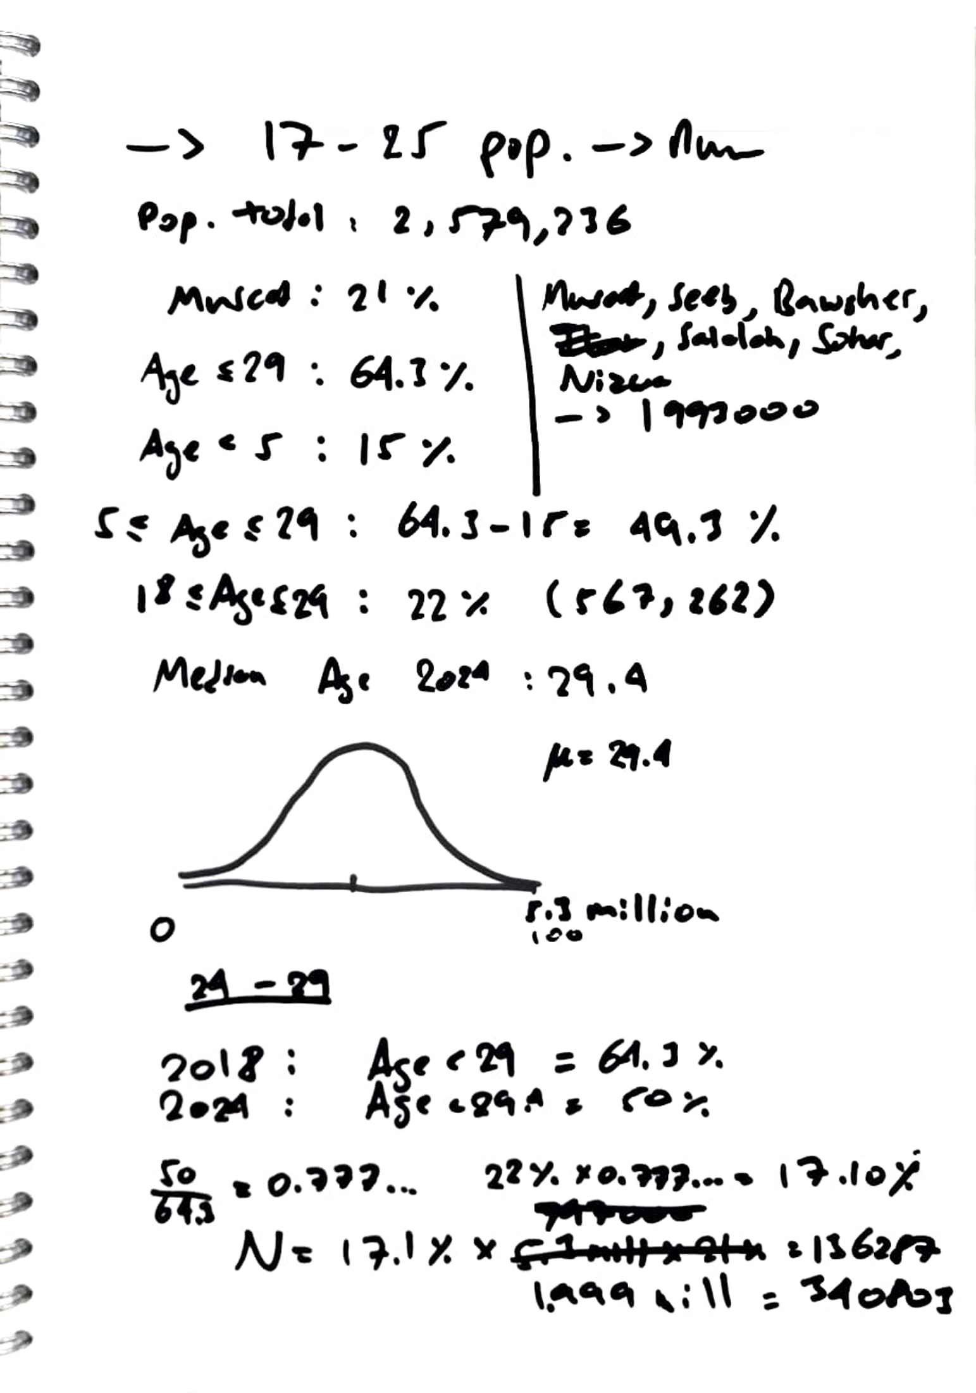
Potential Market in Oman
Based on conducted surveys…
Sample of 33 people
Total of 17 people are unsatisfied with their current VPN
Approximation…
34.4 – 68.5 % of Youth would be interested in another option for protecting their data and privacy
In Oman (according to the Youth Development Index 2018 and NCSI 2024 report), there would be roughly 117,000 to 233,000 potential customers
Digital Fingerprint Protection DLL Injector
Privacy protection
Machine learning
~265%
Growth in global revenue by 2032
Prevents info. requests from sites
Protects user’s digital fingerprint
Protects user’s device
Uses ML algorithm
Adaptable for future fingerprinting techniques
Source: Fortune Business Insights; September 30, 2024

Slide 4
Potential Market in Oman
Based on conducted surveys…
Sample of 33 people
Total of 17 people are unsatisfied with their current VPN
Approximation…
34.4 – 68.5 % of Youth would be interested in another option for protecting their data and privacy
In Oman (according to the Youth Development Index 2018 and NCSI 2024 report), there would be roughly 117,000 to 233,000 potential customers
~265%
Growth in global revenue by 2032
Source: Fortune Business Insights; September 30, 2024
Competition
Competing Products
Our Product
VPNs
Digital Fingerprint can still be identified
Tor Browser
Noticeable delay in performance
Chrome Browser
Gaps where digital fingerprint can be identified
Acedia
Digital fingerprint protection
Lightweight
Adaptation to future fingerprinting techniques (using ML)
Scales with time and data available for training

Slide 5
Potential Market in Oman
Competition
Based on conducted surveys…
Sample of 33 people
Total of 17 people are unsatisfied with their current VPN
Approximation…
34.4 – 68.5 % of Youth would be interested in another option for protecting their data and privacy
In Oman (according to the Youth Development Index 2018 and NCSI 2024 report), there would be roughly 117,000 to 233,000 potential customers
Competing Products
Our Product
VPNs
Digital Fingerprint can still be identified
Tor Browser
Noticeable delay in performance
Chrome Browser
Gaps where digital fingerprint can be identified
Acedia
Digital fingerprint protection
Lightweight
Adaptation to future fingerprinting techniques (using ML)
Scales with time and data available for training
Business Model
Freemium Model
Marketing
Future Goals
Basic version
Model trained on less data
Premium
More accurate model
Social media
Popular social media sites
Conferences
Connecting with other businesses
Selling them our services
Expanding capabilities
Anti packet exfiltration
Improving models accuracy

Slide 6
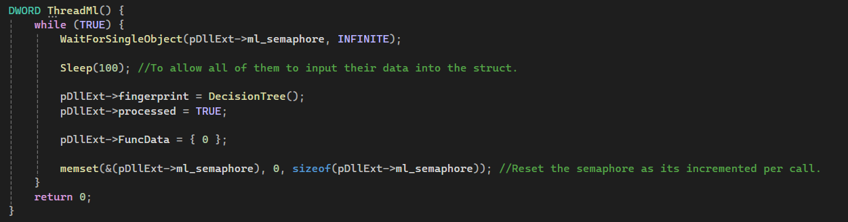
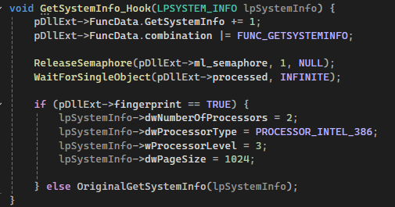
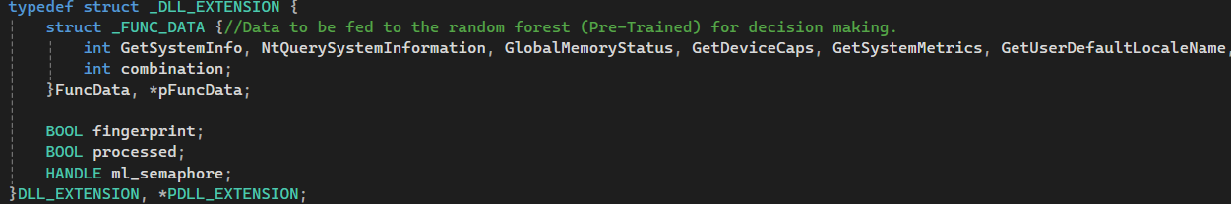
Competition
Business Model
Competing Products
Freemium Model
Marketing
Future Goals
Our Product
VPNs
Digital Fingerprint can still be identified
Tor Browser
Noticeable delay in performance
Chrome Browser
Gaps where digital fingerprint can be identified
Basic version
Model trained on less data
Premium
More accurate model
Social media
Popular social media sites
Conferences
Connecting with other businesses
Selling them our services
Expanding capabilities
Anti packet exfiltration
Improving models accuracy
Acedia
Digital fingerprint protection
Lightweight
Adaptation to future fingerprinting techniques (using ML)
Scales with time and data available for training
Demonstration

Slide 7
Business Model
Marketing
Social media
Popular social media sites
Conferences
Connecting with other businesses
Selling them our services
Demonstration
Freemium Model
Future Goals
Basic version
Model trained on less data
Premium
More accurate model
Expanding capabilities
Anti packet exfiltration
Improving models accuracy
Thank You for your attention!

Slide 8
Demonstration
Thank You for your attention!

